Slide 1
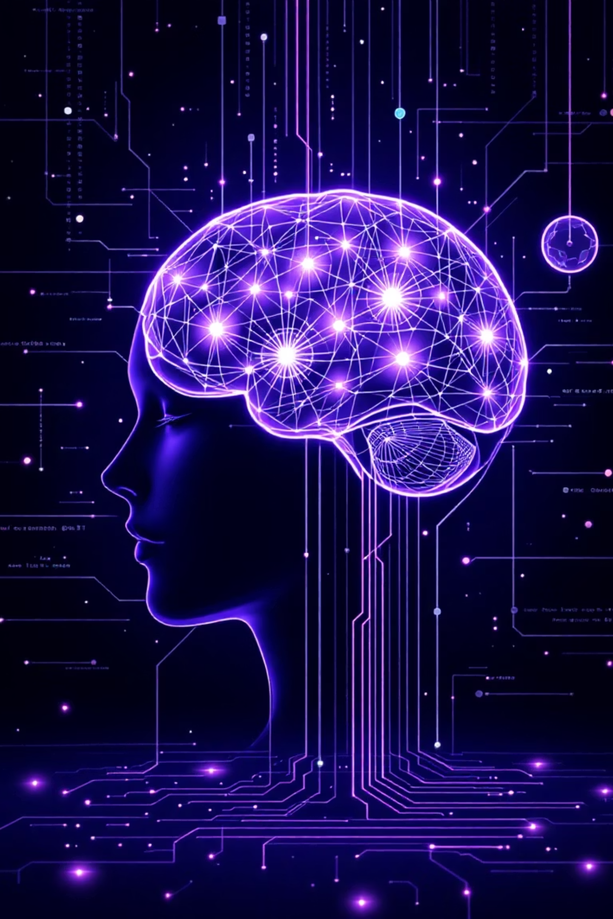
Understanding AI, Machine Learning, and Agentic Systems
This presentation explores the key concepts in artificial intelligence, from basic machine learning to advanced agentic systems. We'll clarify the relationships between these technologies and explain how they're transforming our digital landscape.

Slide 2

The AI Landscape: Key Concepts
Artificial Intelligence (AI)
Machine Learning (ML)
Computers trained to perform tasks that typically require human intelligence, like pattern recognition and understanding visuals, voice, or text.
Machines learn from data to make predictions without explicit programming. You provide input and output, and it figures out the equation itself.
Generative AI
Creates new content like text, images, audio, or video based on prompts. Powered by Large Language Models (LLMs) and other specialized models.

Slide 3


Statistical Machine Learning
Key Characteristics
Common Tasks
Uses algorithms like linear regression, decision trees, and k-means
Classification: Grouping into categories (spam/not spam)
Regression: Predicting continuous numbers (home prices)
Works well with structured data (organized in rows and columns)
Clustering: Grouping unlabeled data based on patterns
Outlier Detection: Finding anomalous data points
Requires less computational power than deep learning
Supervised Learning
Unsupervised Learning
Training with labeled data (input-output pairs)
Finding patterns in unlabeled data without specific guidance

Slide 4

Deep Learning: Neural Networks
Deep Learning uses neural networks inspired by the human brain. It excels with unstructured data like images, videos, audio, and text.
Requirements:
Large amounts of training data
Powerful GPUs for processing
Popular frameworks: PyTorch (beginner-friendly) and TensorFlow (fine-grain control)

Slide 5

The Koala Analogy: How Neural Networks Learn
Feedback Loop
Information Passing
A "supervisor" gives the final answer. If wrong, the error is passed back so they can adjust (backward error propagation)
Specialized Learning
They pass their findings (scores) to others who make higher-level decisions (face, body)
Imagine students (neurons) each specializing in a part of a koala (eyes, nose, ears)

Slide 6
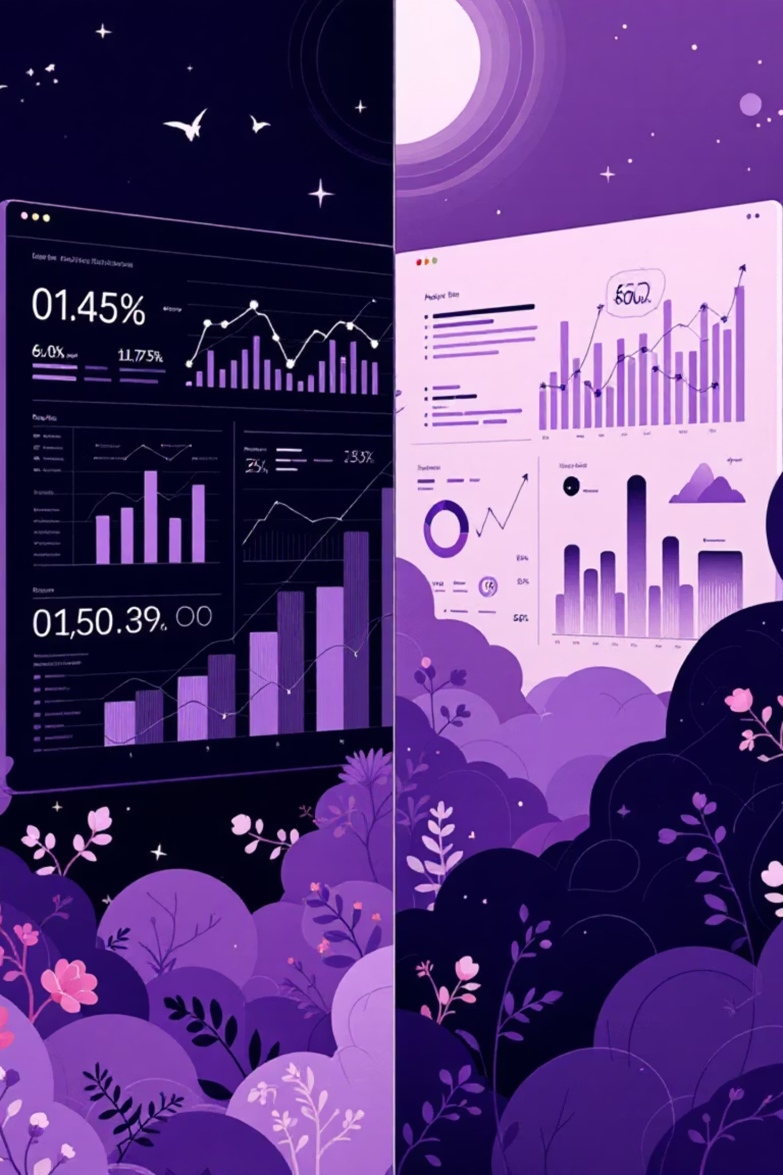
Deep Learning vs. Statistical ML: When to Use Each
Data Type
Feature Complexity
Statistical ML: Structured data (tables, spreadsheets)
Statistical ML: Simple features, clear patterns
Deep Learning: Unstructured data (images, video, audio, text)
Deep Learning: Complex features requiring pattern recognition
Data Volume
Statistical ML: Can work with moderate data sizes
Deep Learning: Performs better with huge training datasets

Slide 7

Generative AI & Large Language Models
Generative AI
Large Language Models (LLMs)
Creates new content (text, images, audio, video)
Neural networks trained on enormous text data
Powered by Large Language Models for text
Contain trillions of parameters
Reacts to prompts with low autonomy
Like a "stochastic parrot" predicting next words
Examples: GPT, DALL-E, AudioGen, Sora
Fine-tuned with Reinforcement Learning with Human Feedback (RLHF)

Slide 8
Agentic AI: Beyond Simple Generation
1
2
3
Goal-Oriented Planning
Multi-step Reasoning
Autonomous Decision-Making
Works toward high-level goals without detailed instructions
Breaks complex goals into multiple logical steps
Performs actions without needing permission for every step
4
5
Heavy Tool Usage
Proactivity
Integrates with external tools and systems through APIs
Actively works toward goals rather than just reacting to questions

Slide 9




The HR Assistant Analogy: Levels of AI Capability
Simple Chatbot
Answers policy questions using Retrieval Augmented Generation (RAG)
Tool-Augmented Chatbot
Takes simple actions (apply for leave) using APIs, but lacks full autonomy
Agentic AI Assistant
Handles complex goals like "onboard a new intern," planning and executing multiple steps autonomously

Slide 10
Generative AI vs. Agentic AI: Key Differences
Generative AI
Agentic AI
Creates content based on prompts
Performs actions toward goals
Reactive to user requests
Proactively reasons and plans
Minimal autonomy
High autonomy
Limited planning capability
Multi-step planning
Minimal tool usage
Heavy tool usage via APIs
Example: Simple ChatGPT Q&A
Example: ChatGPT using tools for deep research
Generative AI is a component within an Agentic AI system, specifically the part that uses LLMs to generate text, summarize, or extract information.

